Slide 1


WHEA Lunch and Learn
November 8, 2018
New Joint Commission Emergency Management Checklist and Proposed Changes to the CMS EM Rules
Marge McFarlane, PhD, MT(ASCP), CHFM, CHSP, CJCP, HEM, MEP
Superior Performance, LLC
mcfarlane.marge@gmail.com

Slide 2
Have Questions??
During the Live Webinar:
Click on “chat” in the lower right-hand corner
If viewing the posted webinar:
Call Marge McFarlane at
715-835-3730 or email at
mcfarlane.marge@gmail.com
Ask a question now via Chat

Slide 3

Learning Objectives
Discuss the purpose of the new Joint Commission EM checklist released November 2018
List the key elements of the checklist
Consider strategies and resources for identifying gaps and opportunities for improvement
Review the proposed revisions to the CMS Emergency Management Rules

Slide 4

Our Mission
Responsibilities:
- legal
- regulatory
- fiscal
- ethical
To design and maintain a safe environment for patients, their family, staff and practitioners

Slide 5
The JC EM Checklist
Released in November 2018 Environment of Care News
Collaborative effort at the request of ASPR
(Office of the Assistant Secretary for Preparedness and Response)
Provides criteria to evaluate elements of EM planning
Use as a gap analysis checklist to ensure your policies/procedures are current

Slide 6
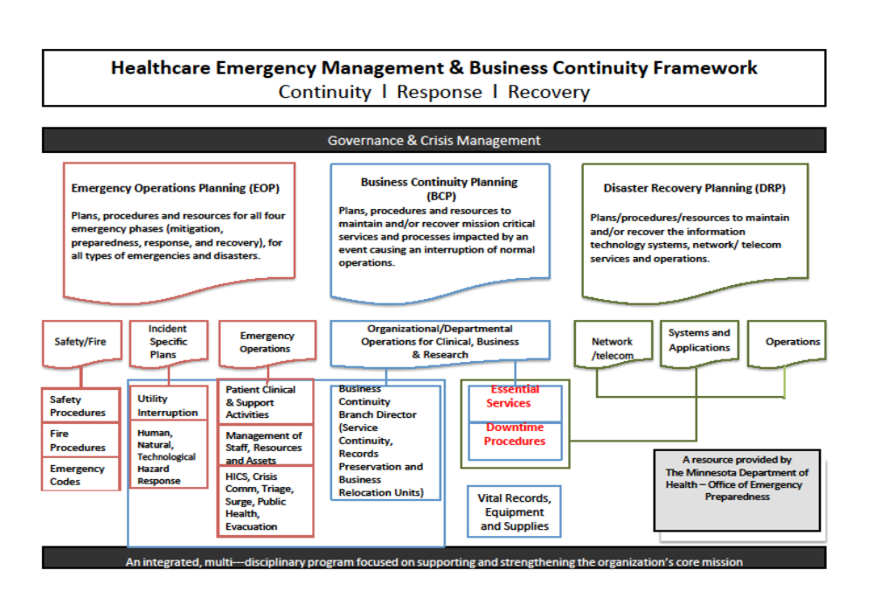

Slide 7
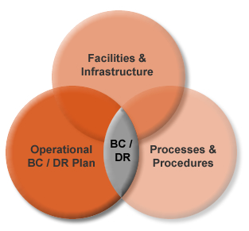
Strategies
Mitigate the hazard risks, exposures, and potential impacts identified in the vulnerability assessment
Keeps the recovery time to a minimum
Recommends plans and procedures to respond to a crisis
Planning is the key to resiliency

Slide 8
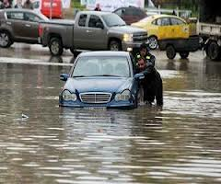
Resiliency
Series of strategies for hardening a building against natural disasters
To plan for, absorb, recover from and more successfully adapt to external weather events
- additional cooling days
- building automation systems down
- major flooding/flash flooding
- storm water management

Slide 9

JC EM Checklist
17 sections required for sustaining the healthcare environment
10 sections required for sustaining clinical services
Checklist set up so that ideally all questions would be marked “yes” unless they were N/A

Slide 10
Management
Enough staff to ensure health and safety
Testing, training and exercises
Adequate resources and supplies
Arrangement for transport to a higher level of care
Surge plan for special needs populations:
dialysis, home ventilators/nebulizers, behavioral health

Slide 11
Continuity of Operations
Program management, plans, and procedures;
Essential/mission critical functions;
Orders of succession; delegations of authority; Continuity communications/information systems; Essential records management
Alternate locations
Human resources
Devolution; reconstitution
Implemented within 12 hours
Operational for up to 30 days

Slide 12
Management (cont.)
1135 Waiver requested in a timely manner
Organization’s insurer been notified
Buildings cleared for occupancy by local AHJ
FEMA protocols followed for reimbursement
https://asprtracie.hhs.gov/technical-resources/resource/2053/a-quick-guide-fema-reimbursement-for-acute-care-hospitals

Slide 13

FEMA $$: Prior to the Event
Written policy on how to capture disaster related expenditures, including labor and materials, through cost centers or purchase orders
Note: Sometimes, having a policy in place prior to a disaster may result in more comprehensive reimbursement
Pre-disaster procedure should be created to track “normal” usage in your institution
FEMA does not reimburse for normal
operating expenses prior to or after a
disaster

Slide 14
FEMA $$: Prior to the Event
Emergency protective measures/preparation activities performed within a reasonable and justified time in advance of the event, may be eligible for reimbursement
Offsite facilities, including physician offices: Contents and operations may be eligible for reimbursement depending on the terms of the lease, insurance and ownership
Set-up zero-dollar cost centers (2 or more) to capture disaster related charges • Cost codes/center should include labor, supplies, pharmaceuticals, equipment, etc.
Notes:
Event reporting timelines available on website Report need for assistance within 30 days of disaster declaration. Most work must be completed within 60 days of the disaster declaration.

Slide 15
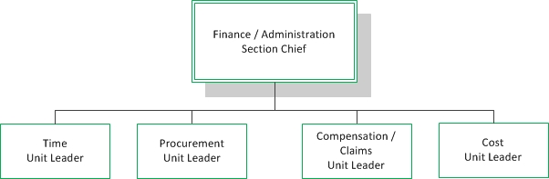
FEMA $$: Prior to the Declaration
Financial and record keeping policies/processes are activated to capture of all disaster related expenditures.
Dedicated person to coordinate the completion/filing of financial related costs. Maintain accurate disbursement and accounting records documented all work performed and costs incurred. (Could be managed out of the Hospital Incident Command structure-Finance)

Slide 16
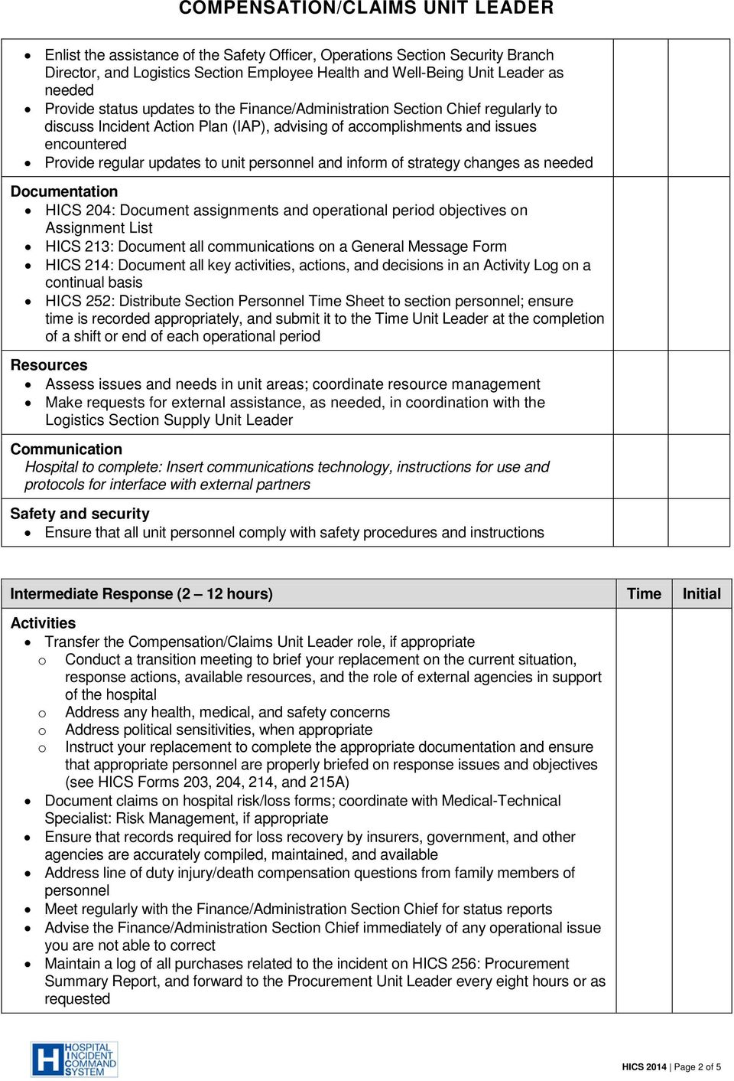

Slide 17
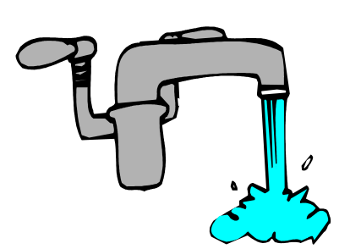
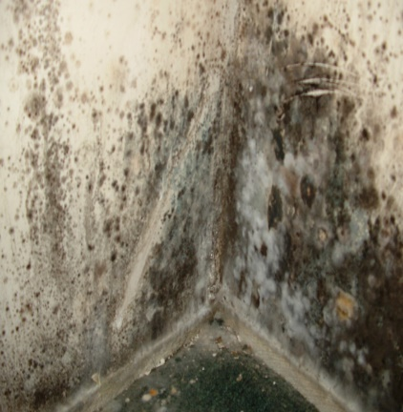
Evaluate Building Integrity
Water quality
Air quality
Mold abatement
Temperature and humidity
Compliance with the Life Safety Code

Slide 18
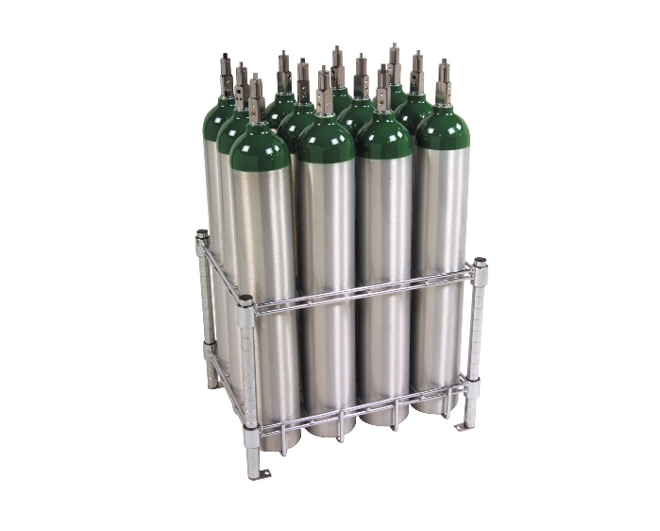
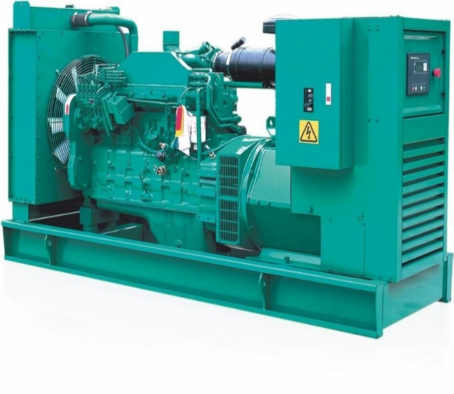
Have the following been assessed?
Consider using HICS Form 251 (www.emsa.ca.gov)
Physical structure/envelope
Medical gasses
Vacuum systems
HVAC
Elevators
Generators
Gas for cooking
Steam for sterilization, heating

Slide 19
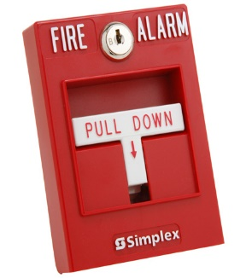
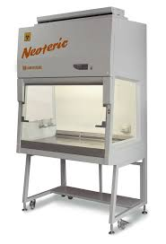
Have the following been assessed?
Sprinklers
Fire alarm system
Vacuum systems
Hood systems (kitchen, lab, pharmacy)
Isolation capabilities
Fuel (diesel)
Restoration of electricity
Potable water/sewage systems
Building automation systems

Slide 20

Access and Availability
Safe access for people and supplies
Community fire, emergency medical and police services available
Staffing and resources adequate to maintain the facilities that are in use

Slide 21

Safety and Food Management
Risk assessment completed
Employee health screenings and vaccinations
Personal protective equipment (PPE) available
Adequate patient equipment and supplies
Mechanism to replenish supplies
Adequate food inventories onsite and available for planned services

Slide 22
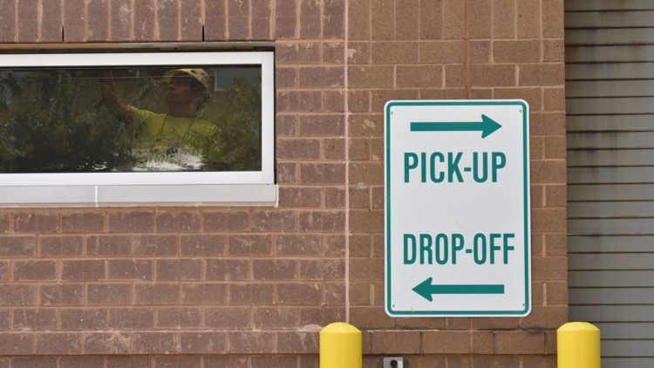
Morgue
Adequate arrangement for
identification, storage and
management of deceased individuals
Adequate arrangements for notification of the family of the location/disposition of the deceased
Disaster Mortuary Operational Response Team (DMORT) ready for deployment – federal team
D-FIRST (Dane Fatality Incident Response Support Team) operated out of Dane County Coroners office

Slide 23

Security
Building and sensitive areas secured
Access controls operational
Identification protocols for those accessing the facility
Law enforcement can be summoned if needed
System in place to track on duty staff
System in place to track locations of
patients sheltered onsite during the emergency
Notes:
Includes security of medical equipment, patient records and pharmaceuticals 24/7 to prevent looting

Slide 24



Hazardous Materials and Wastes
System for general trash removal
System for medical and biohazardous waste
Storage, inventory, disposal systems:
  Radioactive sources and waste
  Pharmaceuticals
  Chemicals
  Other
  Pest and rodent control

Slide 25


Emergency Operations
Plan activated/HICS
Coordination with community partners/HC Coalition
Volunteer management
Donation management
Safe evacuation protocols in place
Systematic protocols for safe reoccupation of the facility

Slide 26


Slide 27
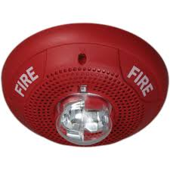

Fire Protection Features
ILSMs in place
Are rated assemblies and components compliant
Fire suppression system in place
Fire detection/notification system in place
Exits clear, unobstructed, functional
Exits discharge to safe areas/locations

Slide 28


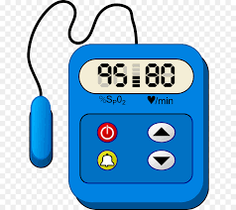
Medical Equipment
Has equipment in flooded or damaged buildings been assessed
Inspection, testing completed
Cleaning and disinfection

Slide 29
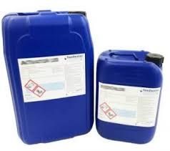
HVAC Inspections
Chillers: pumps, valves and controls, fan coils
Heating: boilers, feedwater, process steam
Distribution systems: ducts, pipes, risers, valves and controls
Chemical treatment systems: water, boiler

Slide 30
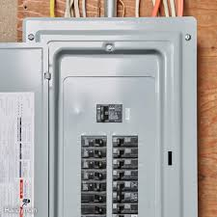
Electrical Systems
Vaults: Main switchboard
Vaults: Utilities transfer switches
Distribution panels: fuses
Distribution panels: breakers
Transformers
Emergency power supply systems: ATS, fuel supply day tank/bulk storage and pumps
Test equipment for confirming voltage and amperage

Slide 31

Water Systems
Potable and non-potable water sources
Distribution pumps
Water towers/tanks
Sewer systems: Sanitary
Sewer systems: Storm
Waste Streams: solid/liquid/lift pumps

Slide 32
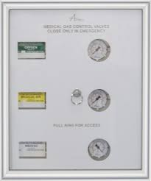
Medical Gas System
Compressors/dryers
Piping system
Vacuum piping and pumps
Anesthetizing gases
Controls (main panel, zone valves, etc.)

Slide 33


Internal/External
Communication Systems
Redundant Communications
Antennas
Cell towers
Cable/Internet
Satellite phones/communications
The Wisconsin Interoperable System for Communications (WISCOM)- VHF/P25 radios

Slide 34
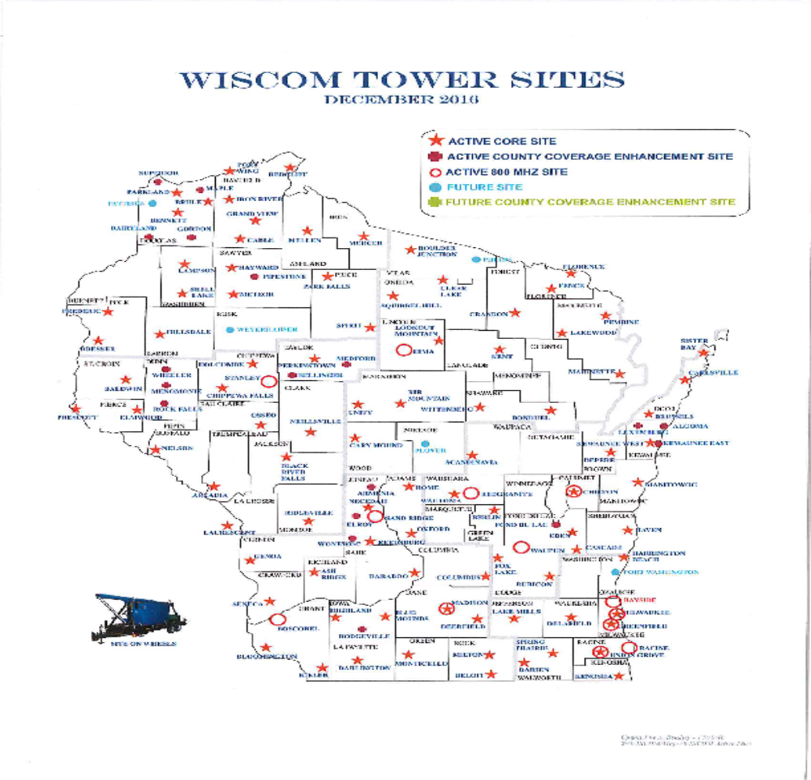

Slide 35
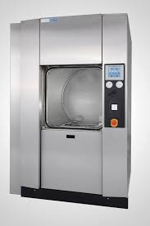
Sterile Procedures Support Systems
Steam (with appropriate water source)
Gas (ethylene oxide)
Cold sterilants (Cidex, glutaraldehyde, etc.)
Air pressure relationships
Temperature/humidity

Slide 36
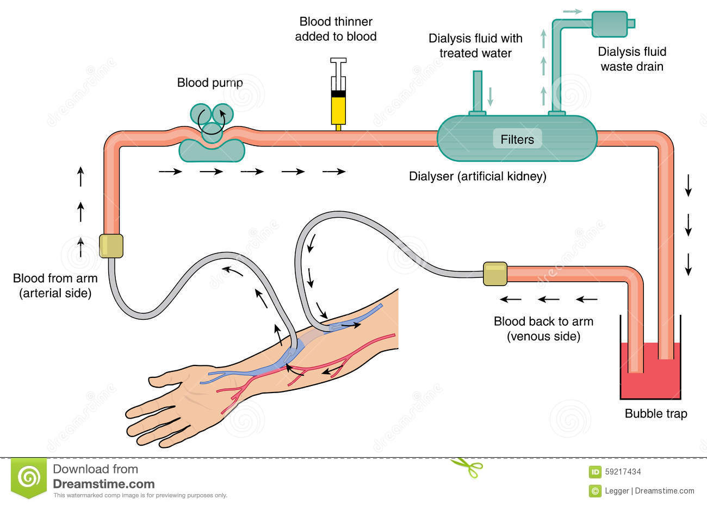
Dialysis
Vulnerable patients needing special diets and dialysis 2-3 time per week for hours at a time
Suitable water sources
Other components and supplies clean and disinfected
Corrosive chemicals used/
eyewash stations needed
Significant biohazardous waste generated

Slide 37


Access and Transportation
For staff and providers
Suppliers and deliveries
Patients and families
Vendor agreements in place
ASHE Annual Conference: MOU vs agreement discussions from 3 impacted hospitals

Slide 38




Required to Provide Clinical Services
Clinical staff/Ancillary staff numbers
Emergency call mechanisms for patients/staff
Mental health support/child/elder care support
Dietary services: supplies, refrigeration, temperature and sanitation
Pharmacy: supplies, temperature, sterility
Laboratory
Radiology

Slide 39

Clinical Services
Surgical Services: sterilization and high-level disinfection
Infection Prevention and Control: handwashing, isolation and identification of communicable diseases
Medical Records: storage, access, security

Slide 40

Allocation of Scare Resources
Triage: for patient needs
Coordination of patient transfer
Process for diversion, closing services, partial or complete evacuation
Process for maximizing medical resources:
substitution, adaptation, conservation, reuse

Slide 41
Proposed Changes to CMS Rules
Published in the Federal Register on September 20, 2018
Proposes requiring hospitals and other providers to review and update their emergency preparedness plan, policies and procedures, communication plan, and training and testing program at least every two years, instead of annually.

Slide 42
Documentation of Efforts to Cooperate with Emergency Preparedness Officials
Proposes eliminating the documentation requirement but retaining the requirement that hospitals and other providers have a process for cooperation and collaboration with emergency preparedness officials.

Slide 43
Periodic Staff Training on Emergency Preparedness Programs
Keeps initial staff training requirements
Would require hospitals and other providers to provide emergency preparedness training at least every two years, instead of annually, and
Require hospitals and other providers to conduct training when the hospital’s or other provider’s emergency preparedness policies and procedures are “significantly updated.”

Slide 44
Second Annual Exercise –
Inpatient Providers
The annual exercise where the provider may choose between a second full-scale exercise or a tabletop exercise, CMS proposes to expand the exercise options to a second full-scale exercise, a tabletop exercise, or a mock disaster drill.
This more in keeping with JC requirement for two functional drills per year
Eliminate 2nd annual exercise for outpatient providers

Slide 45
CMS Comment Period
Comments accepted until 11/19/18 at:
www.federalregister.gov/documents/2018/09/20/2018-19599/medicare-and-medicaid-programs-regulatory-provisions-to-promote-program-efficiency-transparency-and#addresses
Medicare and Medicaid Programs; Regulatory Provisions To Promote Program Efficiency, Transparency, and Burden Reduction

Slide 46
Resources
www.CMS.gov
A Quick Guide: FEMA Reimbursement for Acute Care Hospitals
https://asprtracie.hhs.gov/technical-resources/resource/2053/a-quick-guide-fema-reimbursement-for-acute-care-hospitals
Hospital Incident Command System (HICS) 2014
  www.emsa.ca.gov
  Incident Planning and Response Guides (IPG)(IRG)
  Revised forms/tools in Word and fillable PDF
  Quick Start forms
  HICS guides for many scenarios

Slide 47
Resources
ASPR Tracie Resources
asprtracie.hhs.gov/technical-resources/17/continuity-of-operations-coop-failure-plan/16
State of WI Preparedness Resources
www.dhs.wisconsin.gov/preparedness/index.htm

Slide 48

“Coming together is a beginning,
Keeping together is progress,
Working together is success.”
Henry Ford

Slide 49
Questions?
Marge McFarlane, PhD, MT(ASCP), CHFM, CHSP, CJCP, HEM, MEP
mcfarlane.marge@gmail.com
Superior Performance, LLC
www.margemcfarlane.com

Slide 50
Thank you for your participation!

