Slide 1


Fire & Smoke Dampers
Code/Inspection/Documentation
Thursday, July 13, 2023

Slide 2

Who Are We?
Dave VanZuiden
Commissioning Manager, J.F. Ahern
Wisconsin Designer Of Engineering Systems
5 Years with J.F. Ahern – Senior Engineer, Commissioning Manager
2 Years with IMEG – Senior Mechanical Designer
5 Years with AEI – Mechanical System Designer
3 Years with Henneman Engineering – Mechanical System Designer
J.F. Ahern
Commissioning Group
NEBB TAB Certified Firm
ICB/TABB Certified Firm
ICB/TABB Fire and Smoke Damper Contractor
NEBB TAB Certified Professionals and Techs
ICB/TABB Supervisor and Techs
ICB/TABB Fire & Smoke Damper Supervisors and Techs
ICB/TABB Smoke Control Techs
NEBB Fume Hood Testing Certified Professionals

Slide 3
Type of Life Safety Dampers
Where Do You Need Life Safety Dampers
Life Safety Damper Inspections
Documentation
Example of Failures

Slide 4
Types of Life Safety Dampers

Slide 5
Types of Life Safety Dampers
Fire Damper- A device installed in an air distribution system, designed to close automatically upon detection of heat, to interrupt migratory airflow and to restrict the passage of flame. Fire dampers are classified for use in either static systems or for dynamic systems, where the dampers are rated for closure under airflow.
Smoke Damper- A device within an operating (dynamic) air distribution system to control the movement of smoke.
Fire/ Smoke Combination- A device that meets both the fire damper and smoke damper requirements.
Radiation Damper- A listed device installed in a ceiling membrane of a fire resistance-rated floor-ceiling or roof-ceiling assembly to automatically limit the radiative heat transfer through an air inlet/outlet opening.
Volume Control Damper- A fire damper, smoke damper or combination damper that is also used to control the volume of air in an HVAC system.
Fire Damper
Smoke Damper
Fire/Smoke Damper
Radiation Damper

Slide 6
Types of Life Safety Dampers
Dynamic vs. Static System-
  Dynamic- An HVAC system designed to maintain the movement of air within the system at the indication of fire.
  Static- An HVAC system designed to stop the movement of fire within the system at the indication of a fire.
Dedicated vs. Non-dedicated System-
  Dedicated- Smoke-control systems and components that are installed for the sole purpose of providing smoke control, and upon activation these systems operate specifically to perform the smoke-control function.
  Non-dedicated- Smoke-control system and components that share components with some other system(s), such as the building HVAC system, and upon activation cause the HVAC system to change its mode of operation in order to achieve the smoke-control objectives.

Slide 7
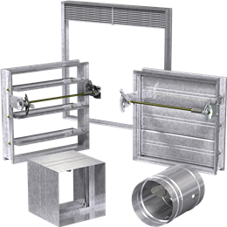
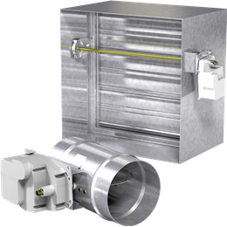
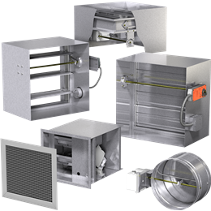
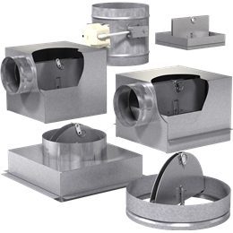
Types of Life Safety Dampers
Fire Dampers
Smoke Dampers
Fire/Smoke Dampers
Radiation Dampers

Slide 8
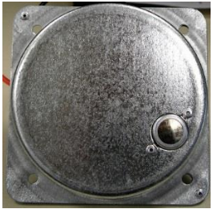
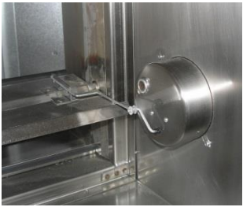
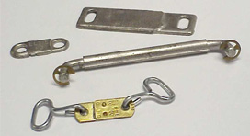
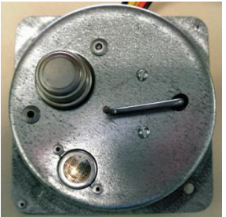
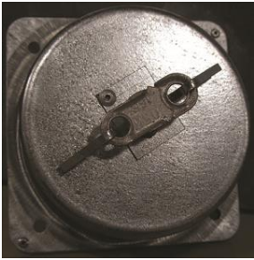
Fire/Smoke Dampers
Types of Life Safety Dampers
Closure Devices
Fire Dampers/Radiation Dampers
Electronic Link
Wired in series with actuator
Electronic Link
With open/close indicator
Fusible Links
165°, 212°, 285°
Electronic Link
With Secondary Override
Pneumatic Relief Valve

Slide 9
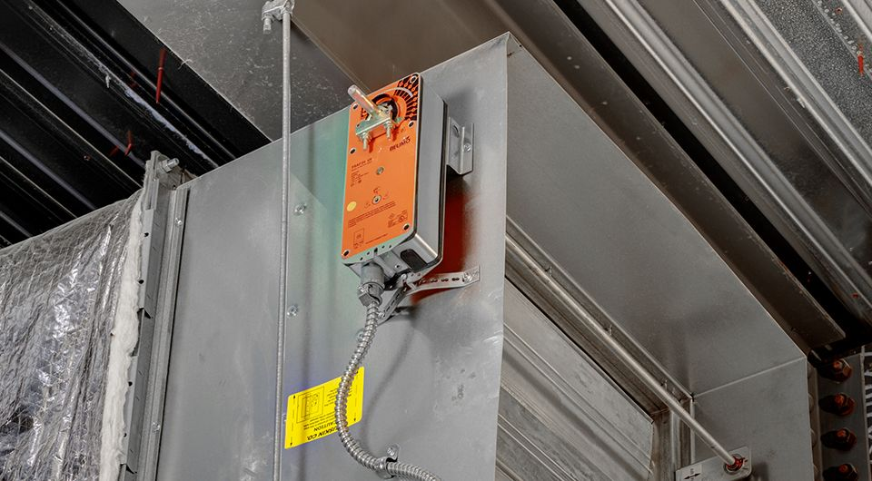
Types of Life Safety Dampers
Fire/Smoke Damper Actuators
Designed for operation during fire event.
Passes UL555 & 555S
Tested at 350°F
20,000 cycles connected to damper

Slide 10
Where Do You Need Life Safety Dampers?

Slide 11


Where Do you Need Dampers?
Codes Dictating Damper Requirements:
2015 IMC 607 – Duct and Transfer Openings
  2015 IMC 607.5 – Where Required
2015 IBC 700 – Fire and Smoke Protection Features
Fire Walls
Fire Barriers
Fire Partitions
Corridor Enclosures
Smoke Barriers
Rated Shafts
Fire Rated Exterior Walls
Smoke Partitions
Fire Rated Horizontal Assemblies
Non-Fire Rated Floor Assemblies

Slide 12
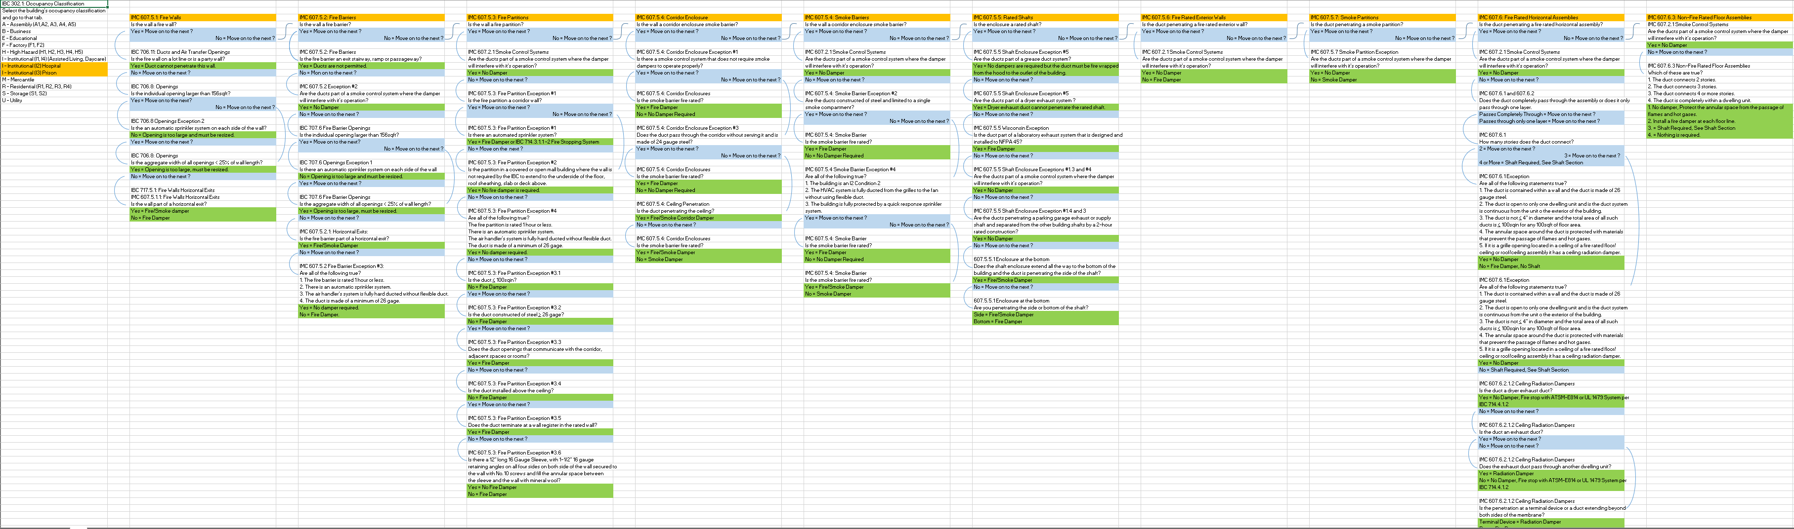
Where Do You Need Dampers?

Slide 13
Life Safety Damper Inspection

Slide 14


Life Safety Damper Inspection
Damper Inspection Code:
NFPA 80 & 105
AHJ’s such as Joint Commission, Fire Marshals and Insurance Risk Auditors Enforce these inspections.

Slide 15
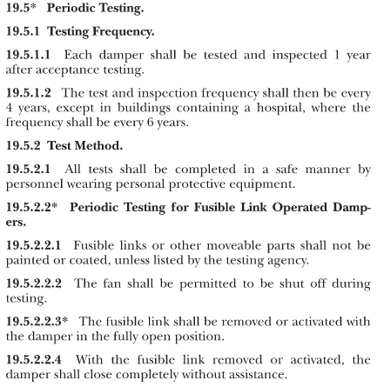
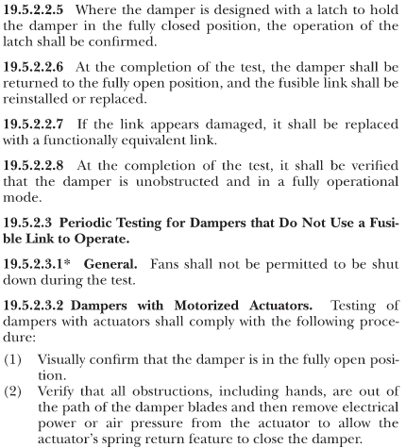
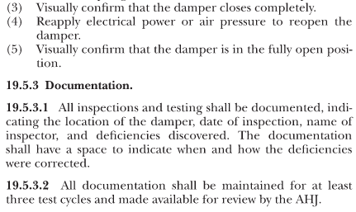
Life Safety Damper Inspection

Slide 16
Life Safety Damper Inspection
Why the difference for Hospitals?
The healthcare industry presented the technical committee with significant evidence that a four-year inspection frequency for fire dampers in hospitals, in these buildings, is a hindrance. Hospitals are unique in that they have many building systems critical to the life safety and health of their occupants (patients). Personnel accessing fire dampers every four years would entail the risk of interfering with or potentially damaging the many systems (HVAC, medical gas systems, sprinkler piping, electrical systems) that are located near the fire dampers and above ceilings. The six-year frequency allows for a reasonable but safe length of time between inspections and also ensures the integrity of the hospital operations.

Slide 17

Life Safety Damper Inspection
Who can/should perform a damper inspection?
Ideally, a certified HVAC technician will perform your fire damper’s inspection. Professionals have a deep understanding of the way fire dampers work and the fire damper inspection requirements. They know what to look for and common issues that may occur. Someone who is not well-versed in fire damping might perform an inspection and miss an issue that would be glaringly obvious to a professional.

Slide 18
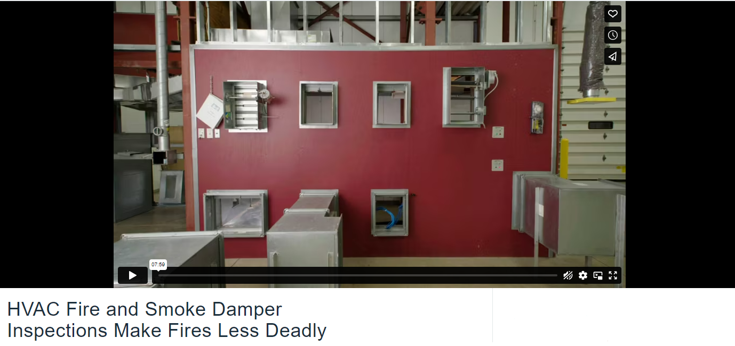
Life Safety Damper Inspection

Slide 19
Life Safety Damper Inspection
What’s Required for Access and Testing Life Safety Damper
ACCESS!
  Both to the ductwork in which the damper is installed and to the damper itself.
Actuating the Damper.
  Remove the Fire Link, Use the Test Button, or Remove Power.
Ensure Smooth Unrestricted Movement.
  Damper must actuate without assonance, getting hung up, or bound up, and close completely.

Slide 20
Documentation

Slide 21
Documentation
Required Documentation
Location of Damper
Date of inspection
Name of the inspector
Deficiencies discovered
This documentation MUST be maintained for AT LEAST 3 Test Cycles and made available for review by the AHJ.

Slide 22
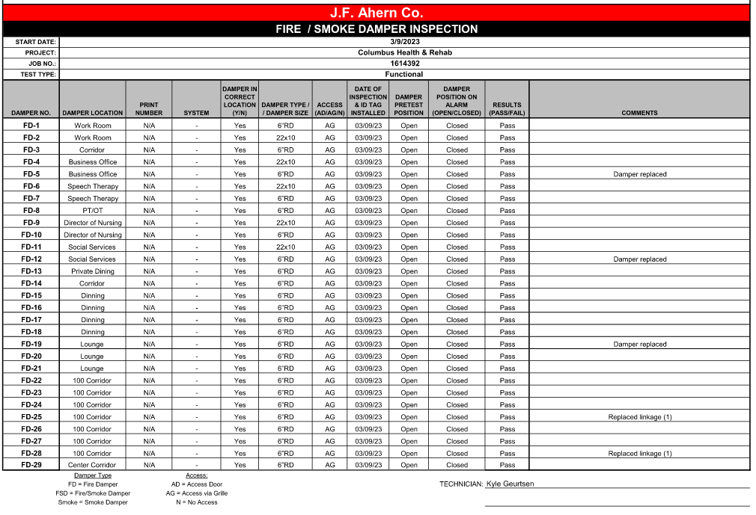
Documentation

Slide 23
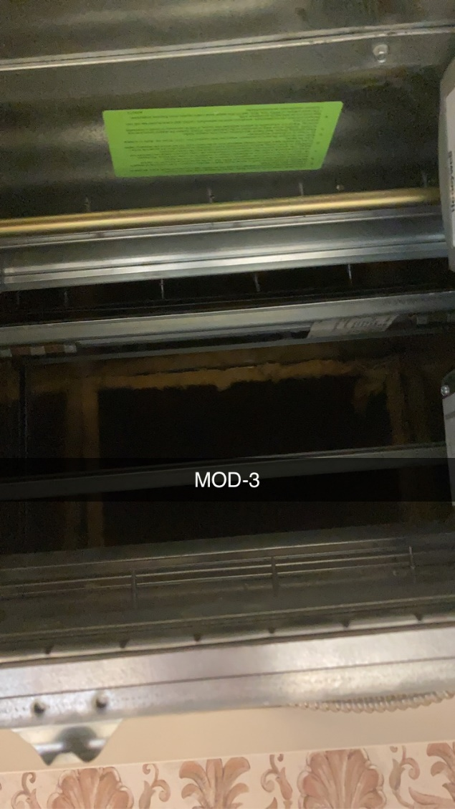
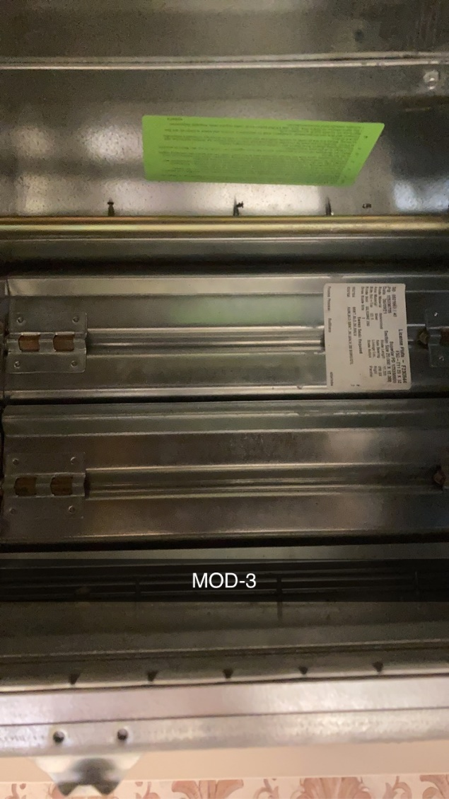
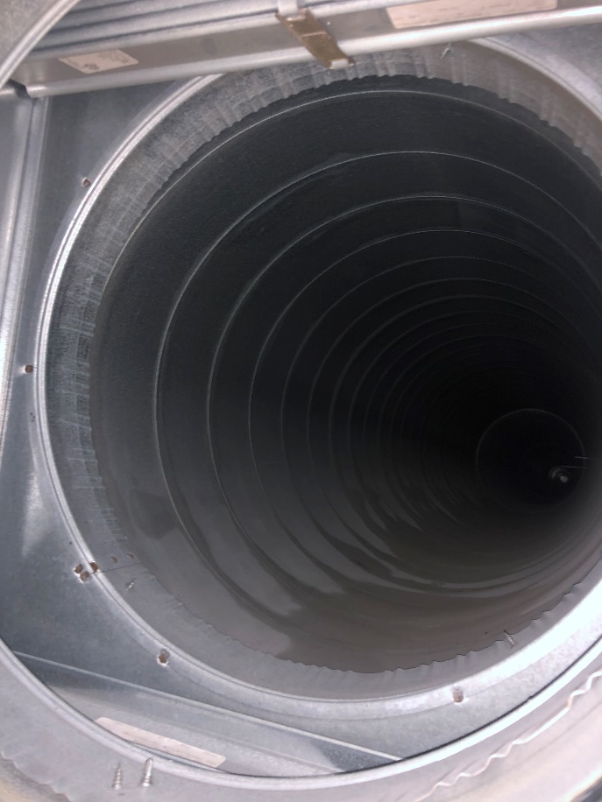
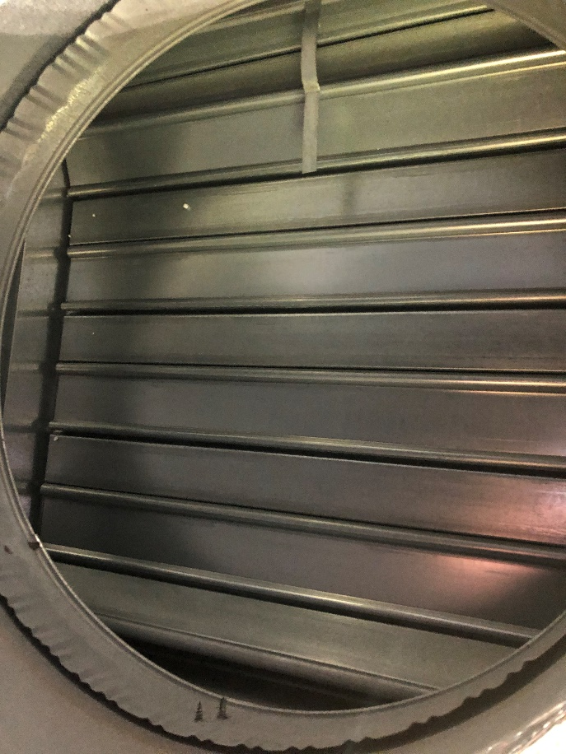
Documentation

Slide 24
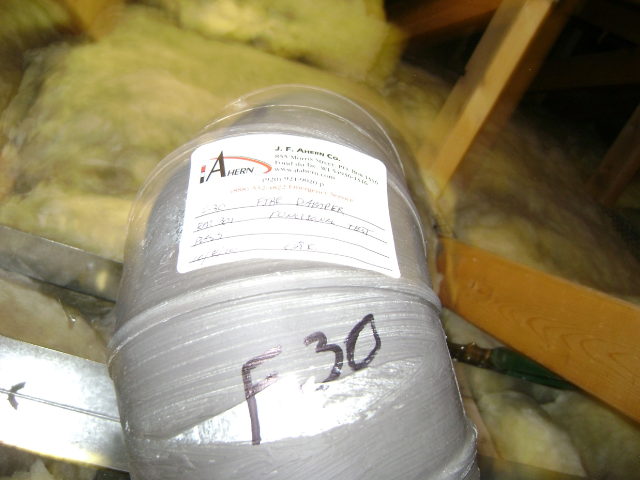
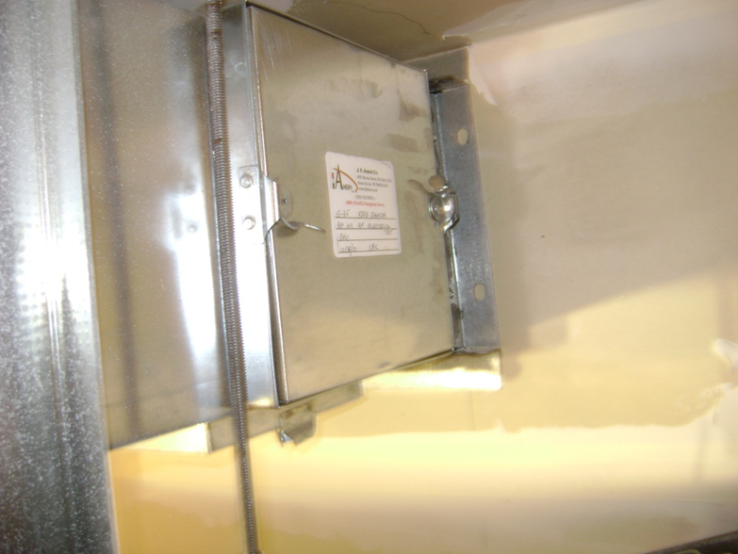
Documentation
Identification Tag

Slide 25
Example of Failures

Slide 26
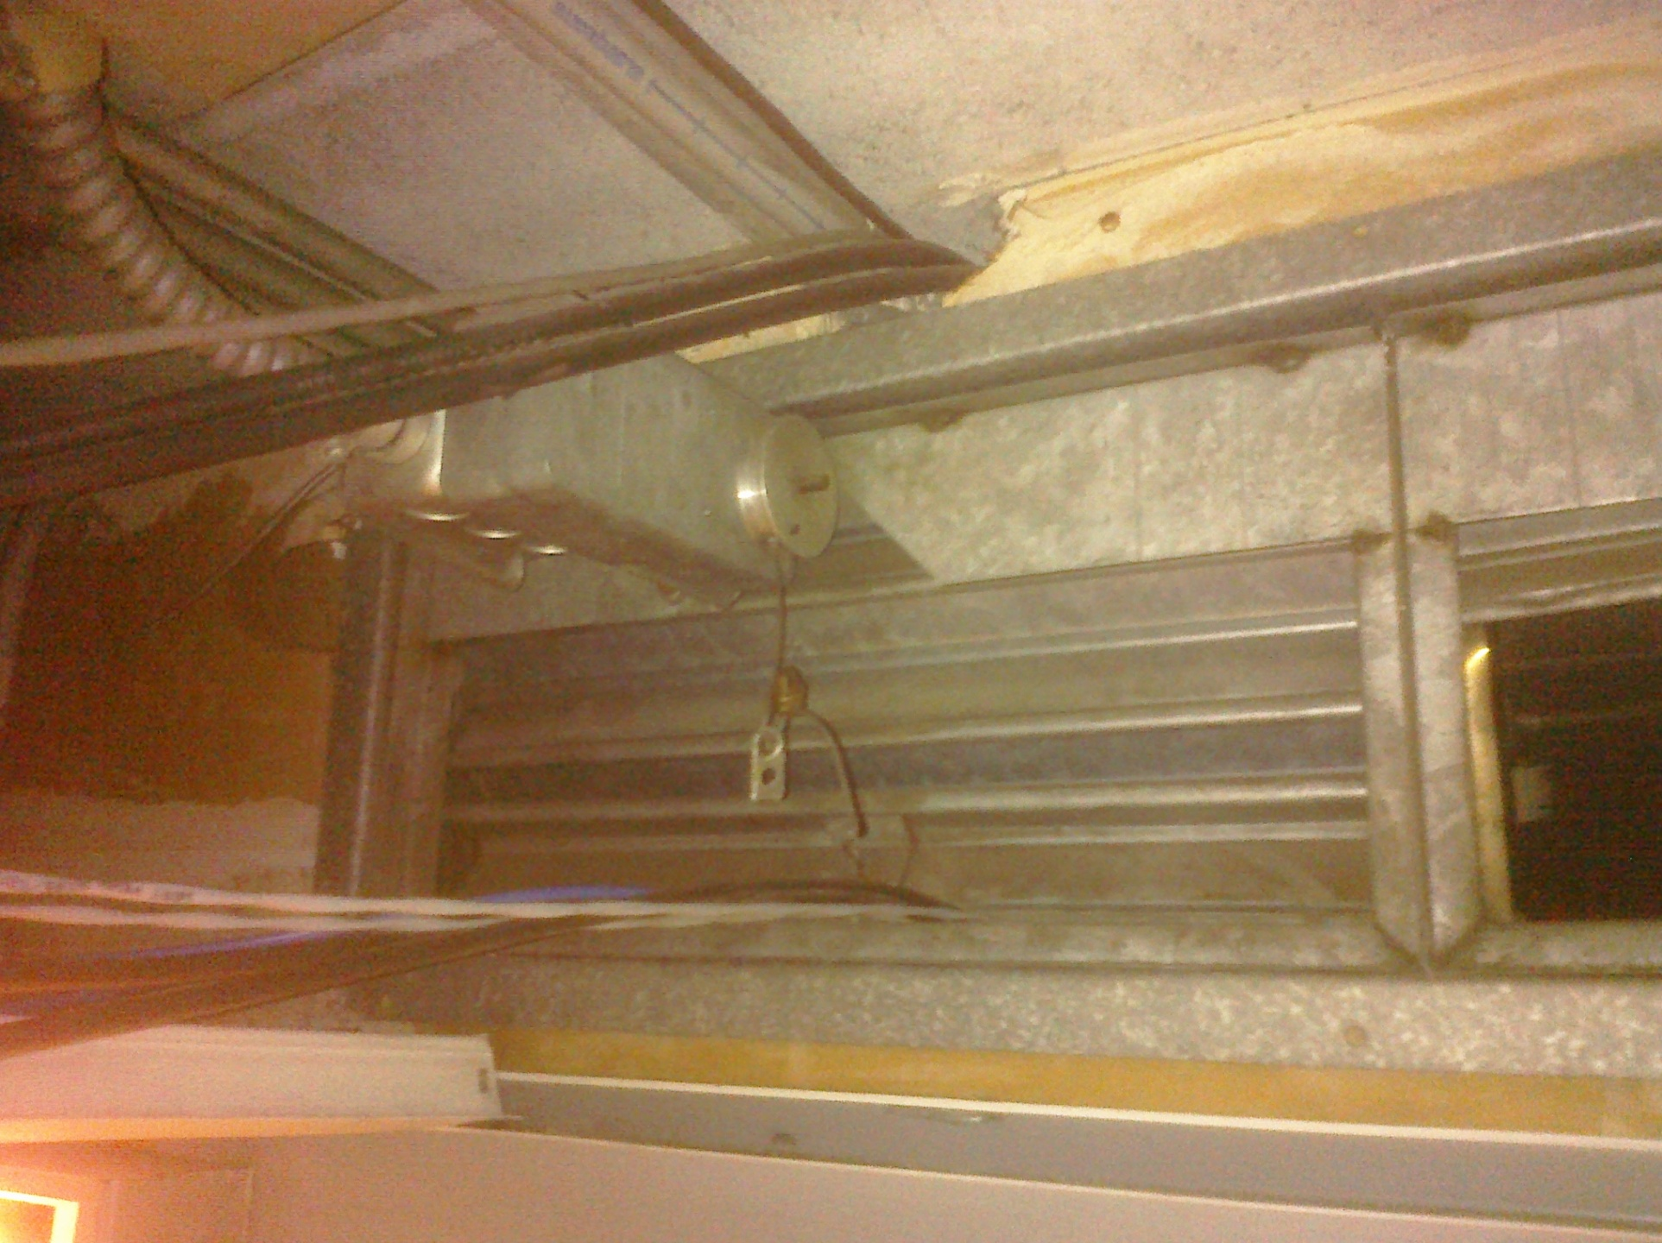
Examples of Failures
Broken Fire Link

Slide 27
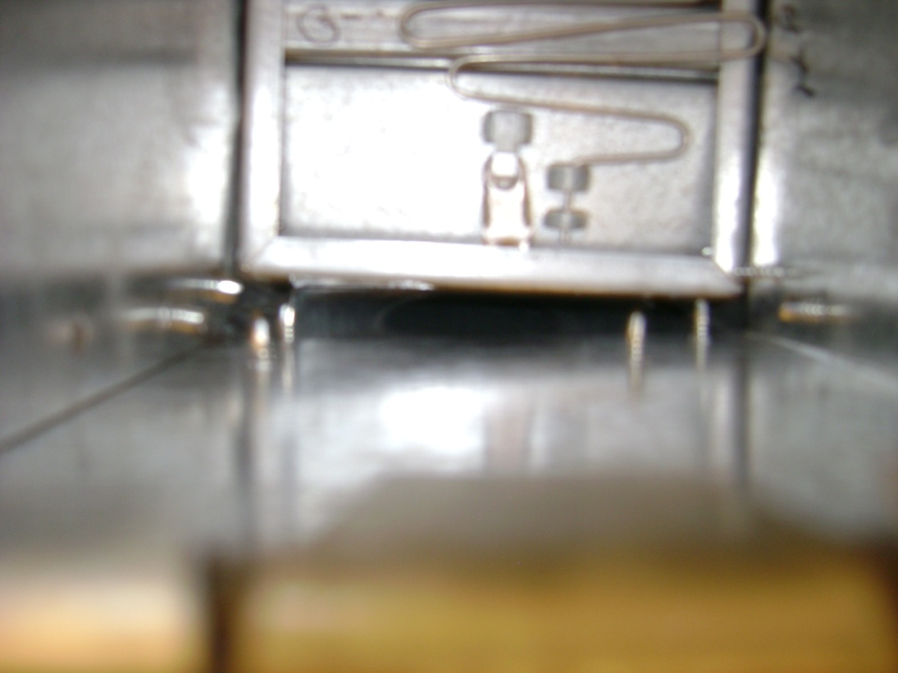
Examples of Failures
Installed with Gap At Bottom

Slide 28
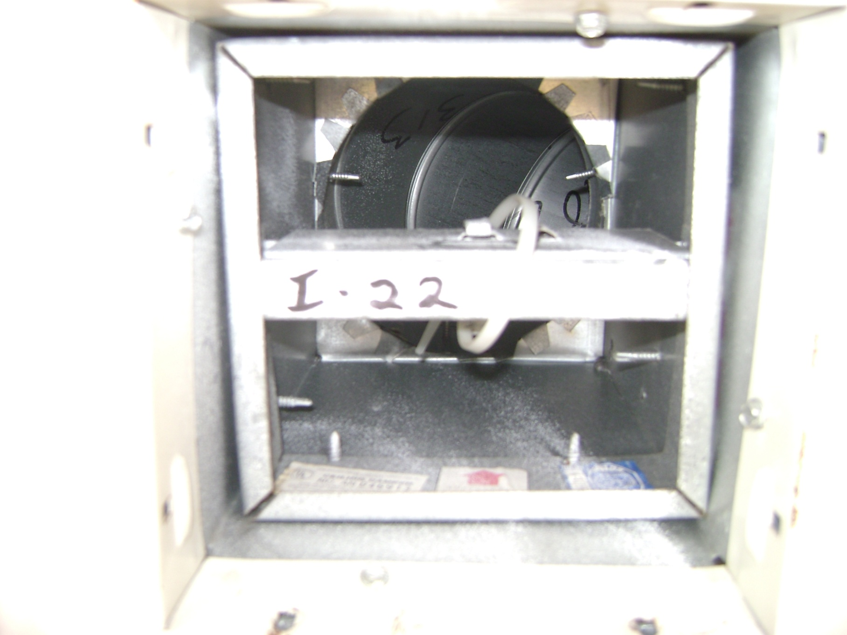
Examples of Failures
Zip Ties are NOT Fire Links

Slide 29
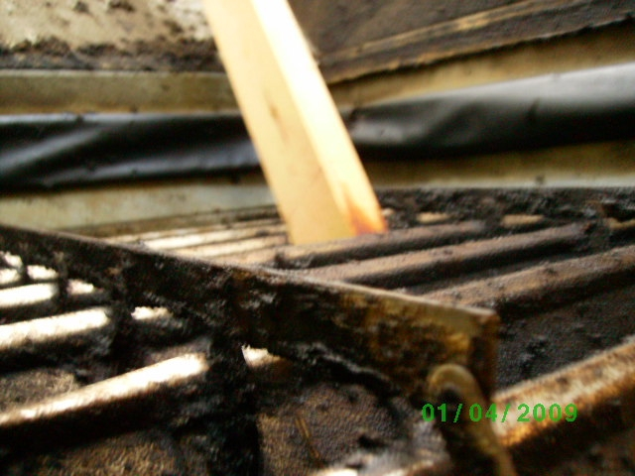
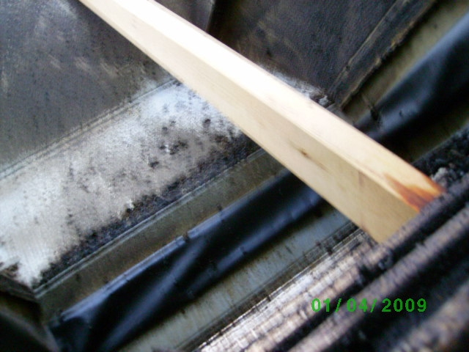
Examples of Failures

Slide 30
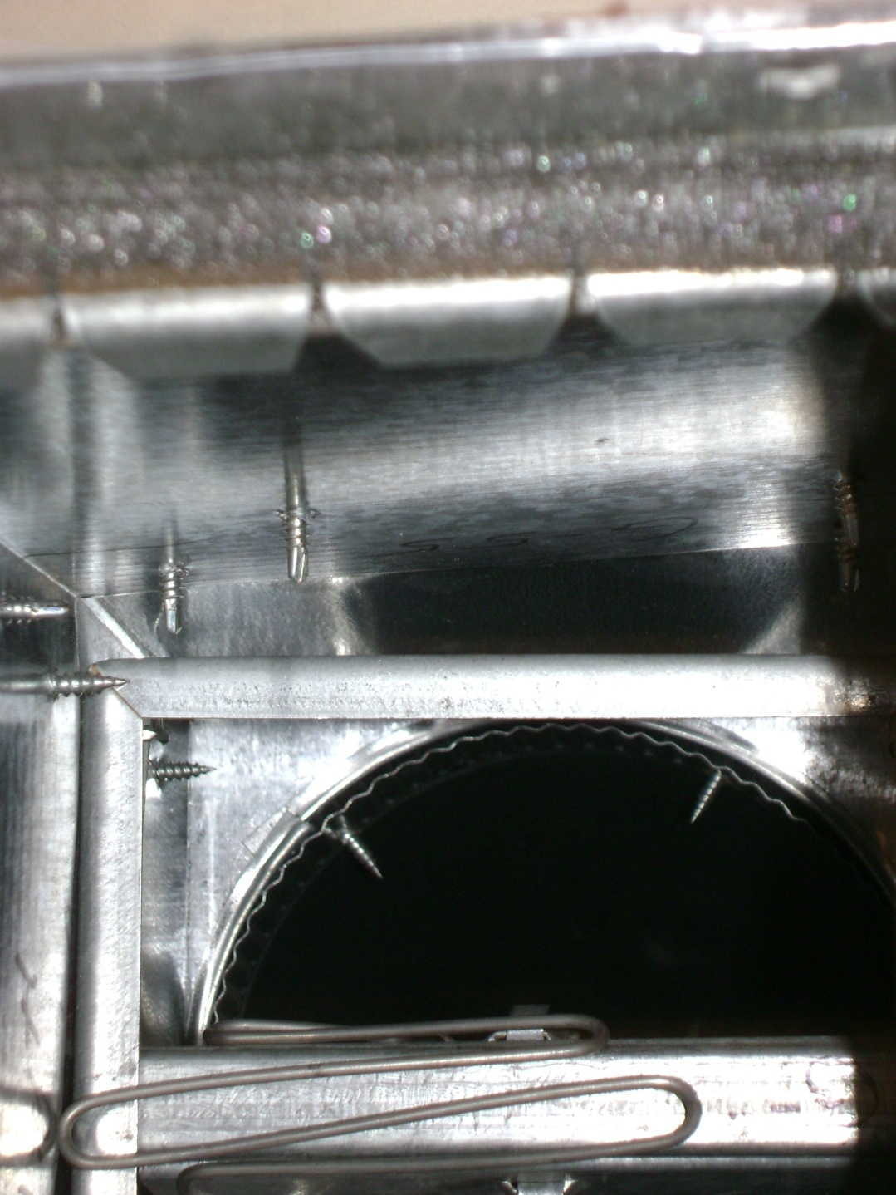
Examples of Failures

Slide 31
Questions?

